Slide 1
Agile SCRUM Methodology
A Introduction to scrum

Slide 2
Agile Manifesto
Individuals and interactions over processes and tools
Working software over comprehensive documentation
Customer collaboration over contract negotiation
Responding to change over following a plan
http://www.agilemanifesto.org

Slide 3
AGAIN
Individuals and interactions
Process and tools
over
Working software
Comprehensive documentation
over
Customer collaboration
Contract negotiation
over
Responding to change
Following a plan
over

Slide 4
Agile Methods
Scrum
Extreme Programming
Adaptive Software Development (ASD)
Dynamic System Development Method (DSDM)
…

Slide 5
Agile Alliance
(www.agilealliance.org) A non-profit organization promotes agile development

Slide 6
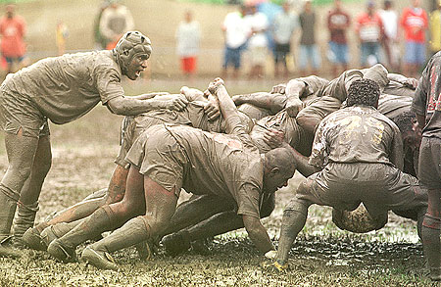
Scrum

Slide 7
Tao Te Ching（17）
太上，不知有之；其次，亲而誉之；其次，畏之；其次，侮之 。信不足焉，有不信焉。犹（悠）兮，其贵言。功成事遂，百姓皆谓“我自然”。
大家没有被管理的感觉，行动不会受到阻碍，自然而然地行事，即为“不知有之”；
公认的管理方式，很符合大家的要求，能够得到团队的赞赏和支持，到达“亲而誉之”的境界；
暴力式的管理方式，用逼迫、压迫的方式让队员“做/不做 什么”会产生“畏之”的后果；
最糟糕的方式就是大家都不认同的管理方式，会导致消极怠工，效率低下，甚至集体离职的严重后果，这就是管理的失败，即造成“悔之”的严重苦果。

Slide 8
Scrum in 100 words
Scrum is an agile process that allows us to focus on delivering the highest business value in the shortest time.
It allows us to rapidly and repeatedly inspect actual working software (every two weeks to one month).
The business sets the priorities. Our teams self-manage to determine the best way to deliver the highest priority features.
Every two weeks to a month anyone can see real working software and decide to release it as is or continue to enhance for another iteration.

Slide 9
History of Scrum
1995:
analysis of common software development processes → not suitable for empirical, unpredictable and non-repeatable processes
Design of a new method: Scrum by Jeff Sutherland & Ken Schwaber
Enhancement of Scrum by Mike Beedle & combination of Scrum with Extreme Programming
1996:
introduction of Scrum at OOPSLA conference
2001:
publication “Agile Software Development with Scrum” by
Ken Schwaber & Mike Beedle
Successful appliance of Scrum in over 50 companies
Founders are members in the Agile Alliance

Slide 10
Characteristics
Self-organizing teams
Product progresses in a series of month-long “sprints”
Requirements are captured as items in a list of “product backlog”
No specific engineering practices prescribed
Uses generative rules to create an agile environment for delivering projects
One of the “agile processes”

Slide 11
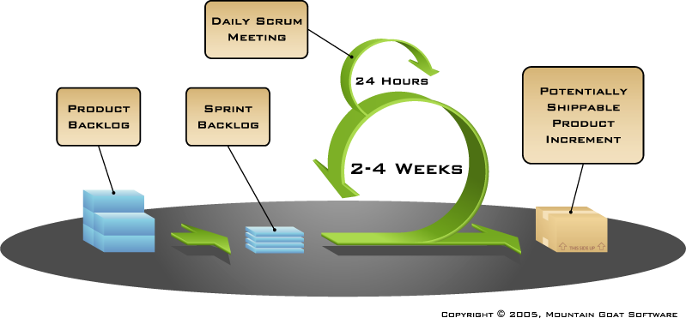
HOW does SCRUM WORK?

Slide 12
Sprints
Scrum projects make progress in a series of “sprints”
Analogous to XP iterations
Target duration is one month
+/- a week or two
But, a constant duration leads to a better rhythm
Product is designed, coded, and tested during the sprint

Slide 13
No changes during the sprint
Plan sprint durations around how long you can commit to keeping change out of the sprint
Change
Inputs
Sprint
Tested Code

Slide 14
Scrum Framework
Roles : Product Owner, ScrumMaster, Team
Ceremonies : Sprint Planning, Sprint Review, Sprint Retrospective, & Daily Scrum Meeting
Artifacts : Product Backlog, Sprint Backlog, and Burndown Chart

Slide 15
Product Owner
Define the features of the product
Decide on release date and content
Be responsible for the profitability of the product (ROI)
Prioritize features according to market value
Adjust features and priority every iteration, as needed
Accept or reject work results.

Slide 16
The Scrum Master
Represents management to the project
Responsible for enacting Scrum values and practices
Removes impediments
Ensure that the team is fully functional and productive
Enable close cooperation across all roles and functions
Shield the team from external interferences

Slide 17
Scrum Team
Typically 5-10 people
Cross-functional
QA, Programmers, UI Designers, etc.
Members should be full-time
May be exceptions (e.g., System Admin, etc.)
Teams are self-organizing
What to do if a team self-organizes someone off the team??
Ideally, no titles but rarely a possibility
Membership can change only between sprints

Slide 18
Ceremonies
Sprint Planning Meeting
Sprint
Daily Scrum
Sprint Review Meeting
Retrospective Meeting

Slide 19
Spring Planning Meeting
Scrum Team
Management
Product Owner
Customers
Product Backlog
Sprint Planning
Meeting
Team Capabilities
Sprint Goal
Business Conditions
Technology
Sprint Backlog
Current Product

Slide 20
Parts of Sprint Planning Meeting
1st Part:
Creating Product Backlog
Determining the Sprint Goal.
Participants: Product Owner, Scrum Master, Scrum Team
2nd Part:
Participants: Scrum Master, Scrum Team
Creating Sprint Backlog

Slide 21
Pre-Project/Kickoff Meeting
A special form of Sprint Planning Meeting
Meeting before the begin of the Project

Slide 22
Sprint
A month-long iteration, during which is incremented a product functionality
NO outside influence can interfere with the Scrum team during the Sprint
Each Sprint begins with the Daily Scrum Meeting

Slide 23
Daily Scrum
Parameters
Daily
15-minutes
Stand-up
Not for problem solving
Three questions:
What did you do yesterday
What will you do today?
What obstacles are in your way?
Chickens and pigs are invited
Help avoid other unnecessary meetings
Only pigs can talk

Slide 24
Daily Scrum
Is NOT a problem solving session
Is NOT a way to collect information about WHO is behind the schedule
Is a meeting in which team members make commitments to each other and to the Scrum Master
Is a good way for a Scrum Master to track the progress of the Team

Slide 25
Scrum FAQs
Why daily?
“How does a project get to be a year late?”
“One day at a time.”
Fred Brooks, The Mythical Man-Month.
Can Scrum meetings be replaced by emailed status reports?
No
Entire team sees the whole picture every day
Create peer pressure to do what you say you’ll do

Slide 26
Sprint Review Meeting
Team presents what it accomplished during the sprint
Typically takes the form of a demo of new features or underlying architecture
Informal
2-hour prep time rule
Participants
Customers
Management
Product Owner
Other engineers

Slide 27
Sprint Retrospective Meeting
Scrum Team only
Feedback meeting
Three questions
Start
Stop
Continue
Don’t skip for the first 5-6 sprints!!!

Slide 28
Product Backlog
A list of all desired work on the project
Usually a combination of
story-based work (“let user search and replace”)
task-based work (“improve exception handling”)
List is prioritized by the Product Owner
Typically a Product Manager, Marketing, Internal Customer, etc.

Slide 29
Product Backlog
Requirements for a system, expressed as a prioritized list of Backlog Items
Is managed and owned by a Product Owner
Spreadsheet (typically)
Usually is created during the Sprint Planning Meeting
Can be changed and re-prioritized before each PM

Slide 30
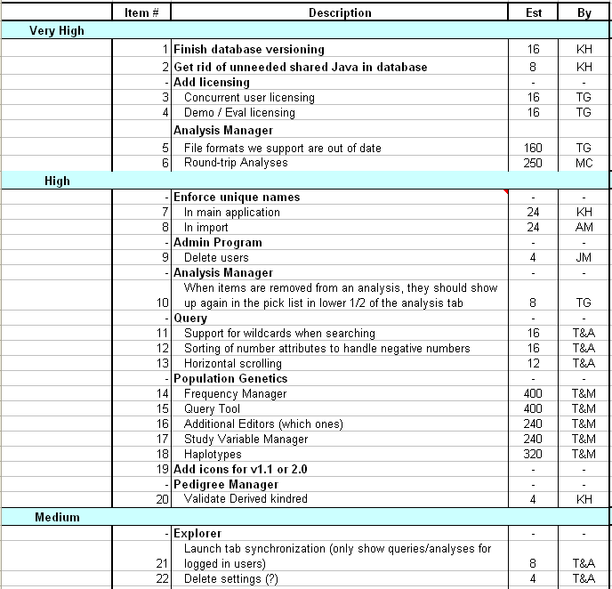
Sample Product Backlog

Slide 31
From Sprint Goal to Sprint Backlog
Scrum team takes the Sprint Goal and decides what tasks are necessary
Team self-organizes around how they’ll meet the Sprint Goal
Manager doesn’t assign tasks to individuals
Managers don’t make decisions for the team
Sprint Backlog is created

Slide 32
Sprint Backlog during the Sprint
Changes
Team adds new tasks whenever they need to in order to meet the Sprint Goal
Team can remove unnecessary tasks
But: Sprint Backlog can only be updated by the team
Estimates are updated whenever there’s new information

Slide 33
Sprint Backlog
A subset of Product Backlog Items, which define the work for a Sprint
Is created ONLY by Team members
Each Item has it’s own status
Should be updated every day

Slide 34
Sprint Backlog
No more than 300 tasks in the list
If a task requires more than 16 hours, it should be broken down
Team can add or subtract items from the list. Product Owner is not allowed to do it

Slide 35
Sprint Burn down Chart
Depicts the total Sprint Backlog hours remaining per day
Shows the estimated amount of time to release
Ideally should burn down to zero to the end of the Sprint
Actually is not a straight line
Can bump UP

Slide 36
Information Radiator
"Two characteristics are key to a good information radiator. The first is that the information changes over time. This makes it worth a person's while to look at the display... The other characteristic is that it takes very little energy to view the display."

Slide 37
Sprint Burndown Chart

Slide 38
Scalability of Scrum
A typical Scrum team is 6-10 people
Jeff Sutherland - up to over 800 people
"Scrum of Scrums" or what called "Meta-Scrum“
Frequency of meetings is based on the degree of coupling between packets

Slide 39
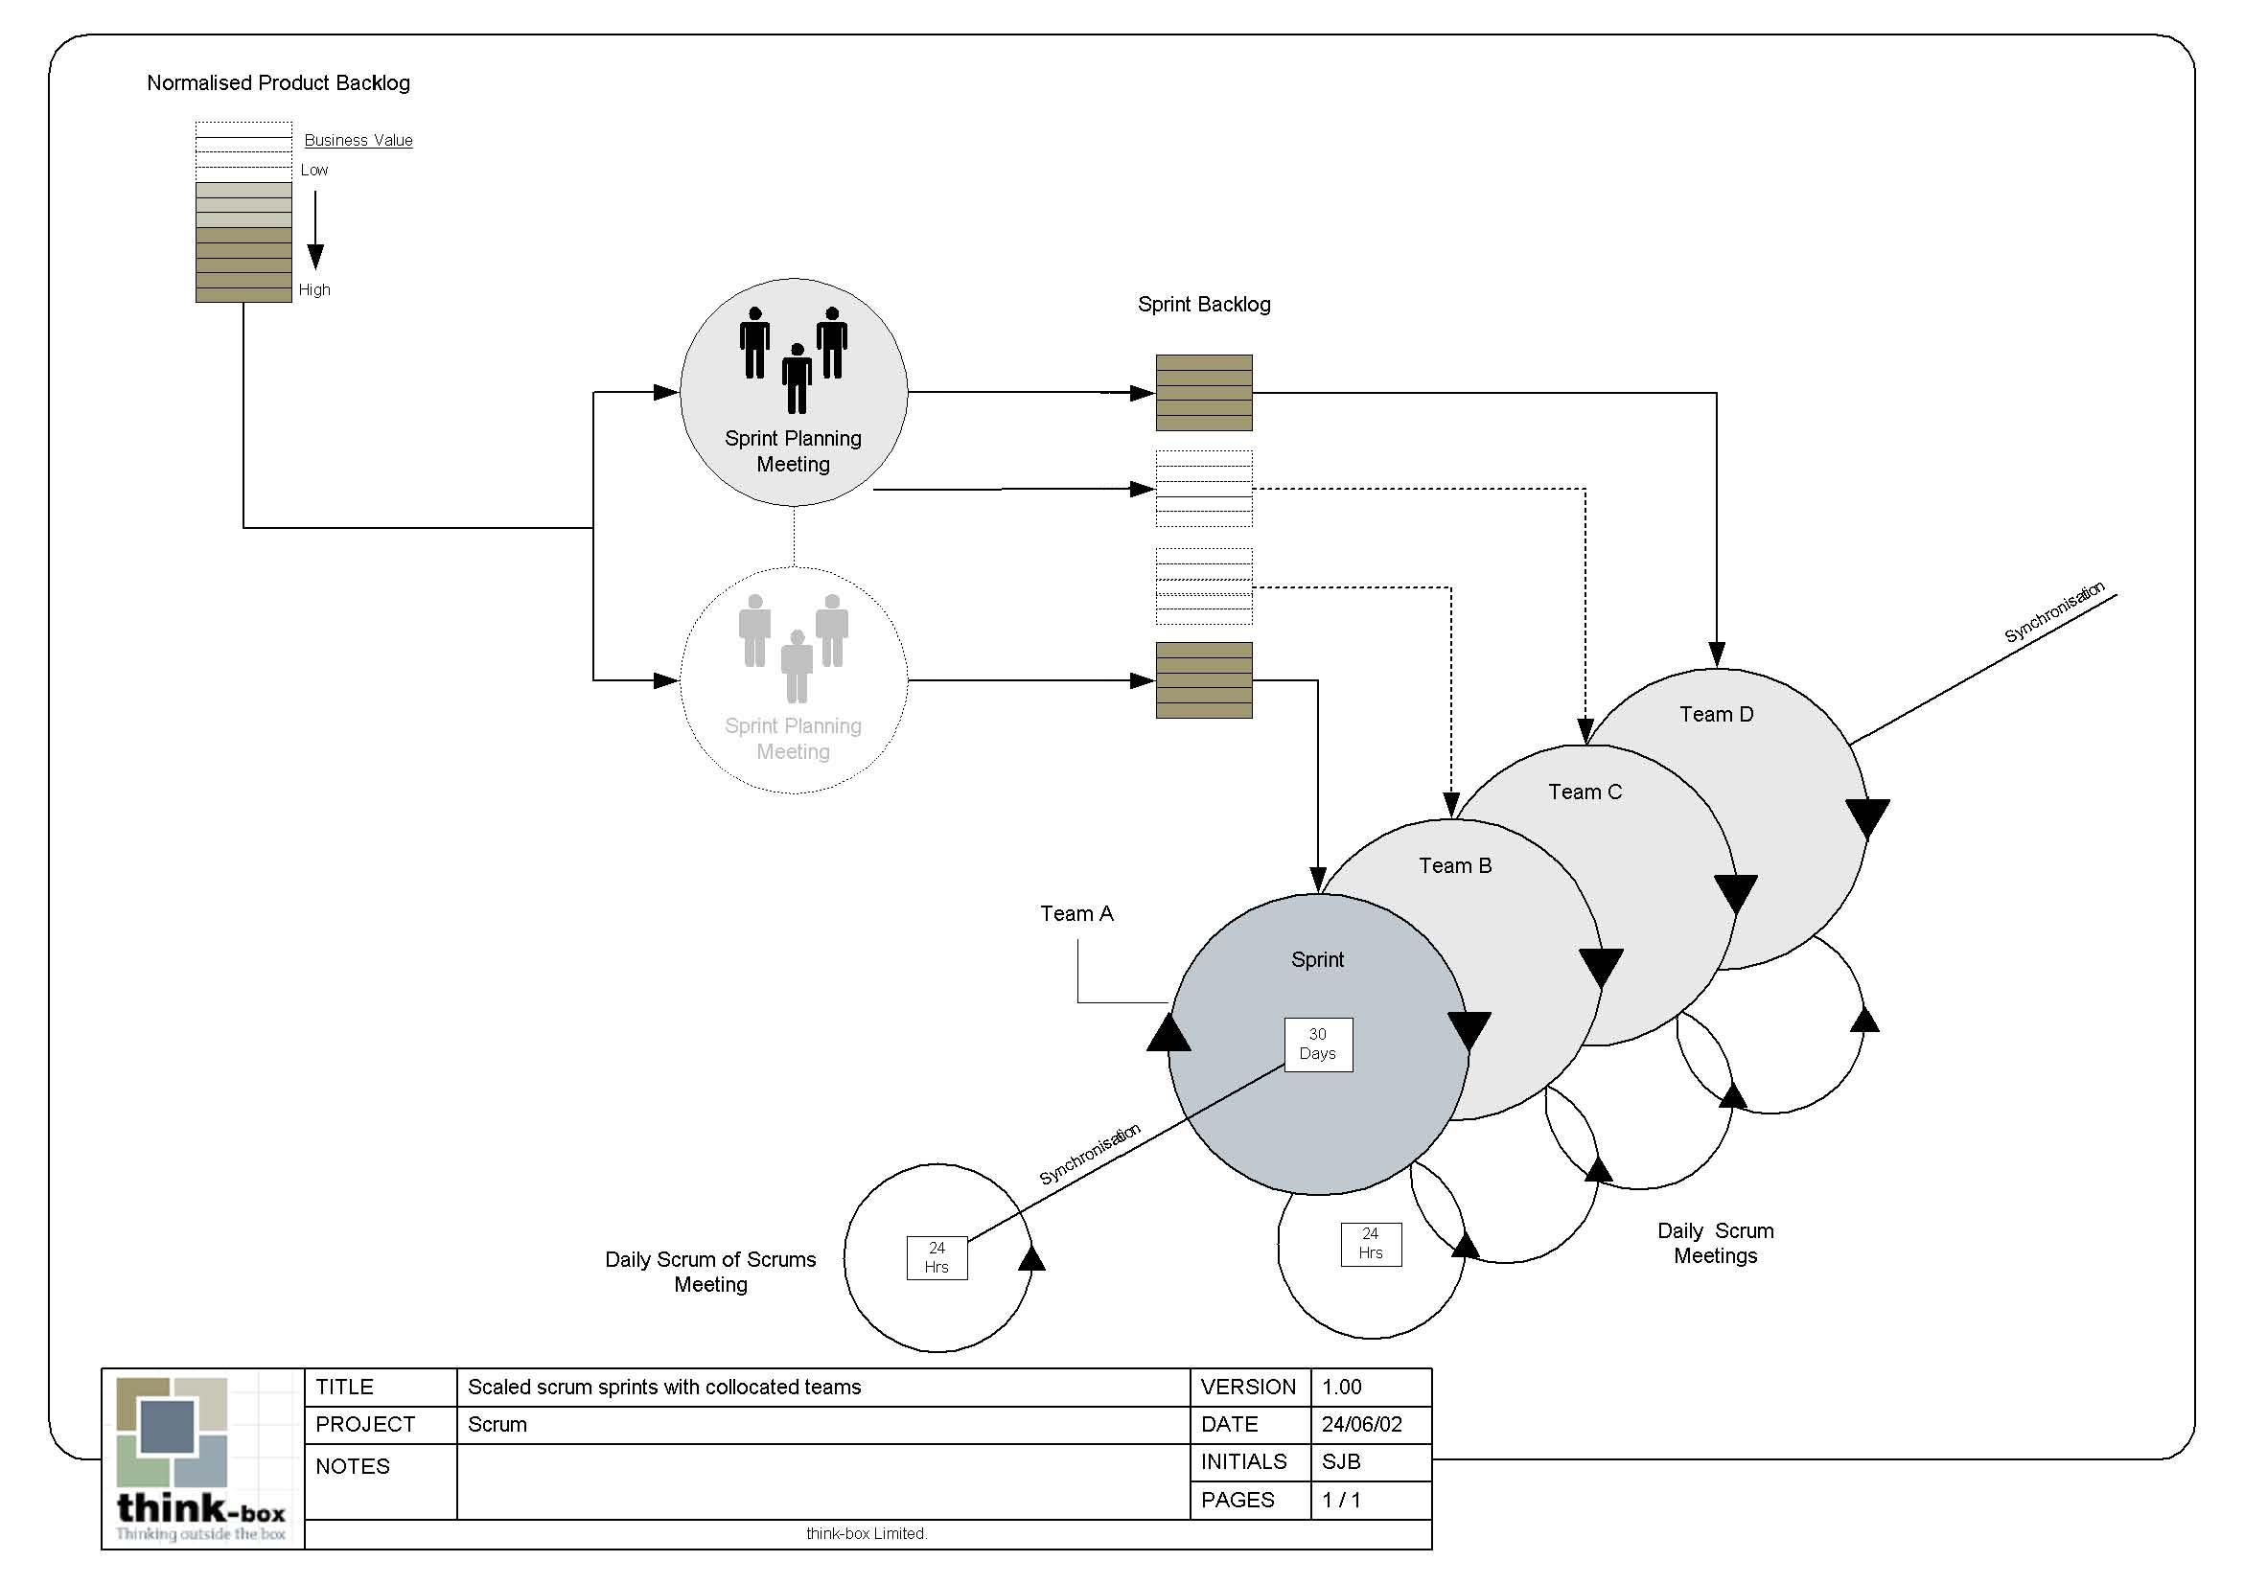
Scalability of Scrum

Slide 40
Pros/Cons
Advantages
Drawbacks
Completely developed and tested features in short iterations
Simplicity of the process
Clearly defined rules
Increasing productivity
Self-organizing
each team member carries a lot of responsibility
Improved communication
Combination with Extreme Programming
“Undisciplined hacking” (no written documentation)
Violation of responsibility
Current mainly carried by the inventors

Slide 41
Credits & References
Mike Cohn, Mountain Goat Software www.mountaingoatsoftware.com
Scrum and The Enterprise by Ken Schwaber
Succeeding with Agile by Mike Cohn
Agile Software Development Ecosystems by Jim Highsmith
Agile Software Development with Scrum by K. Schwaber and M. Beedle
User Stories Applied for Agile Software Development by Mike Cohn
www.agilescrum.com/
www.objectmentor.com
jeffsutherland.com/
www.controlchaos.com/scrumwp.htm
agilealliance.com/articles/articles/InventingScrum.pdf

Slide 42
Tao Te Ching（17）
太上，不知有之；其次，亲而誉之；其次，畏之；其次，侮之 。信不足焉，有不信焉。犹（悠）兮，其贵言。功成事遂，百姓皆谓“我自然”。
大家没有被管理的感觉，行动不会受到阻碍，自然而然地行事，即为“不知有之”；
公认的管理方式，很符合大家的要求，能够得到团队的赞赏和支持，到达“亲而誉之”的境界；
暴力式的管理方式，用逼迫、压迫的方式让队员“做/不做 什么”会产生“畏之”的后果；
最糟糕的方式就是大家都不认同的管理方式，会导致消极怠工，效率低下，甚至集体离职的严重后果，这就是管理的失败，即造成“悔之”的严重苦果。

Slide 43
Thank You !

